Slide 1

Maker Space
Kyler Kershaw
Marcus Mitchell
Daniel Bigler
Jessica Prater

Slide 2
Who we are
Kyler
Marcus
Daniel
Jessica

Slide 3
What does the application do?
Monitor currently scheduled bookings
Login/Create new user accounts
Monitor updates on site progress
Admin access.

Slide 4
Front End
Responsible for designing and formatting.
Putting info as far as explaining what is a makerspace and how can a person maker their own.

Slide 5
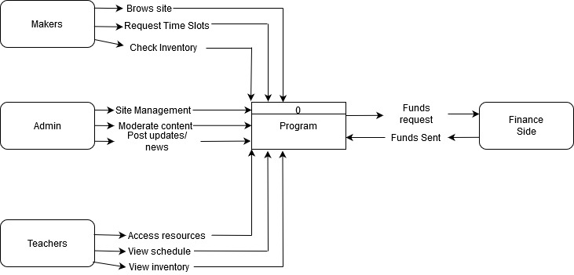
Context diagram

Slide 6
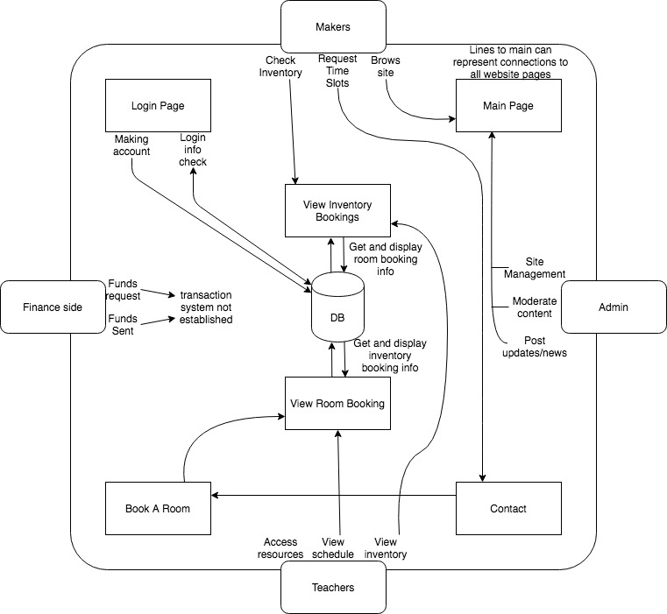
Diagram Zero

Slide 7
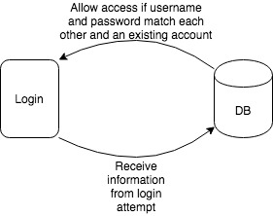
Login Diagram

Slide 8
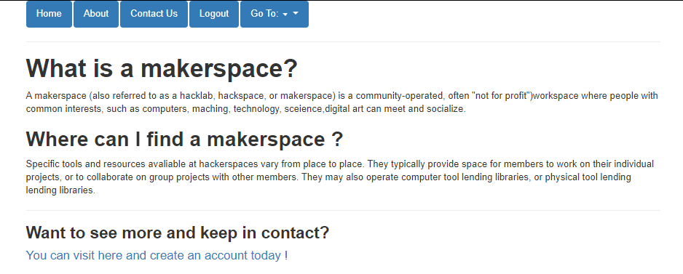
About Maker Space
This page displays a small bit about what a maker space is.

Slide 9
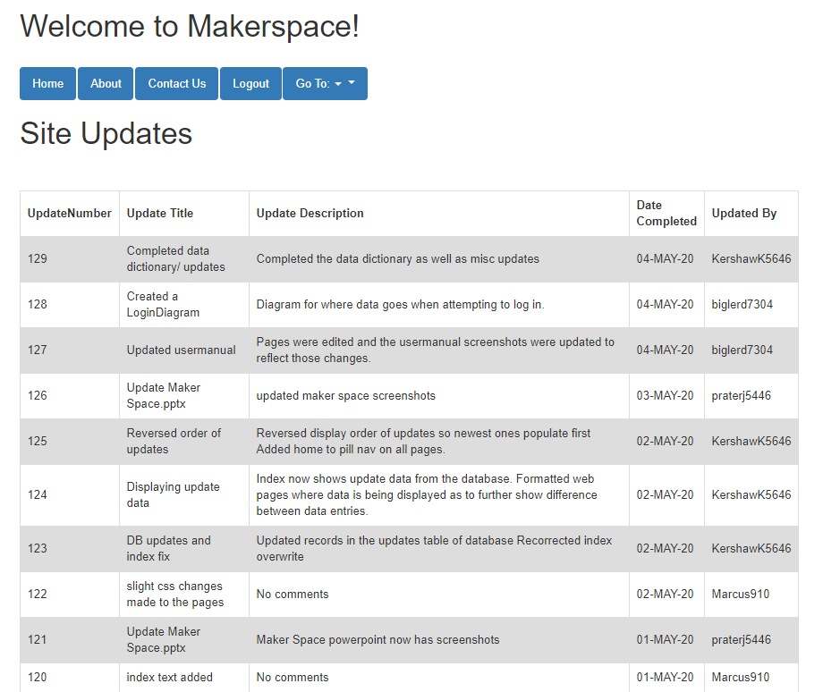
Welcome
The welcome page displays
Login option
Create account option
Site/Project update logs

Slide 10
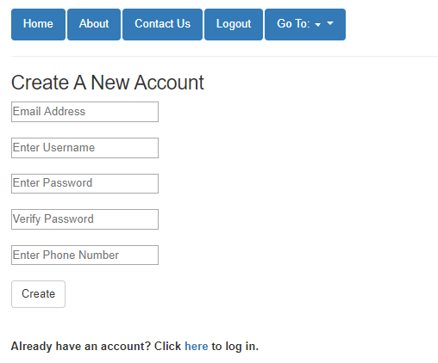
Create Account
Creating an account is a quick and simple process. All that is required are:
Email
Username
Password (as well as password verification)
Phone Number

Slide 11
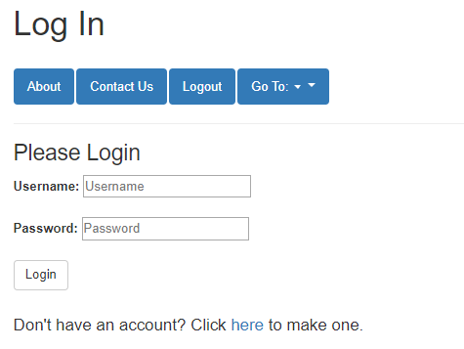
Login
The Login page requires;
Username
Password

Slide 12
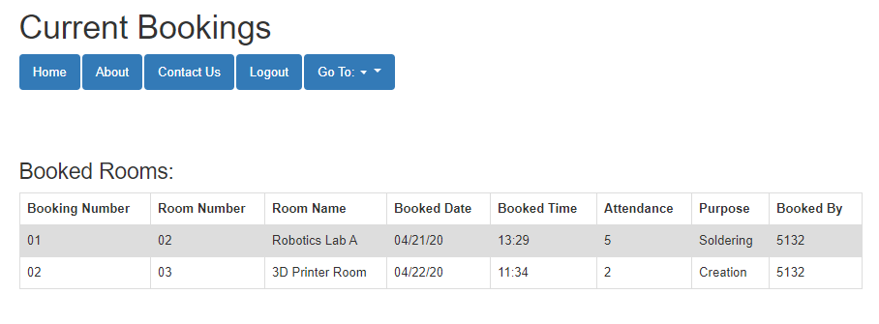
View Room Bookings
Room Booking currently shows rooms that are currently booked.

Slide 13
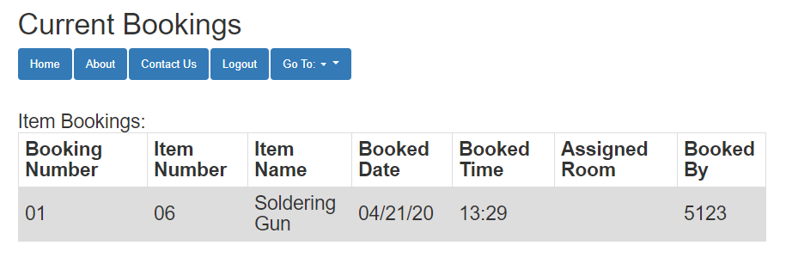
Inventory Bookings
Inventory Booking currently shows items that are currently booked.

Slide 14
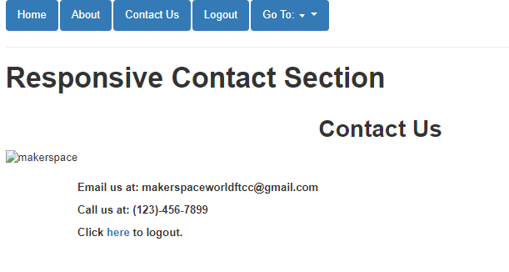
Contact
Contact currently shows contacts of email and phone number to be able to get help or to book a room.

Slide 15
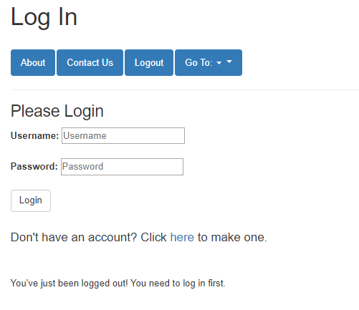
Logout
When you logout, it takes you to the login page and displays a message to show that you have logged out

Slide 16
Q&A
Questions?

